Slide 1
Characterizing TCR γ𝛅 T cells in tissues and disease
Toufic Mayassi
University of Chicago
Jabri Lab

Slide 2
Approach
TCR- Delta Chain
VD1
DN
VD2
Disease
Control
Gluten Free CD
Active CD
Tissue
Blood
Intestine

Slide 3
Sorting Strategy
1
2
3
4
5
DN
Notes:
Figure 1. TCR ɣδ IEL are increased in CD
A) Intraepithelial lymphocytes (IEL) and peripheral blood lymphocytes (PBL) were isolated from subjects and stained for the surface markers CD3 (UCHT1), TCRɣδ (SA6.E9), TCR αβ (IP26), Vδ1 (TS8.2) and Vδ2 (B6). The populations Vδ1, Vδ2, and DN were sorted as gated here for TCR sequencing. B) Analysis of frequency of TCRɣδ IEL shown as a % of total CD3 positive lymphocytes based on gating strategy from A. C) Analysis of frequency of Vδ1, 2, DN TCRɣδ IEL shown as a % of total CD3 positive lymphocytes. D) Analysis of frequency of TCRɣδ PBL shown as a % of total CD3 positive lymphocytes. E) Analysis of frequency of Vδ1, 2, DN TCRɣδ PBL shown as a % of total CD3 positive lymphocytes.

Slide 4
Composition and frequency of TCR ɣδ T cells across tissue and disease
Blood
Intestine
Notes:
----- Meeting Notes (6/8/15 09:31) -----
Remove VD2/DN and add next slide here.

Slide 5
Is there a selection for particular delta chains
Blood
Intestine

Slide 6
ex vivo Cytokine Production

Slide 7
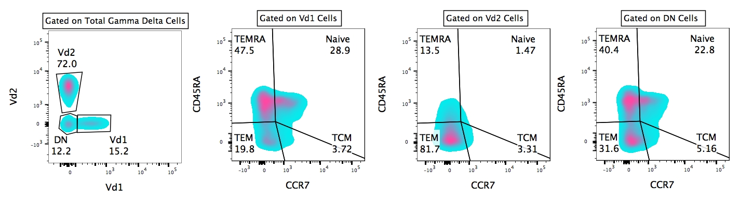
Disease Independent Heterogeneity in the TCR ɣδ PBL Compartment
A.
B.
C.

Slide 8
Template-Switch Anchored RT-PCR
Moloney Murine Leukemia Virus (MMLV) reverse transcriptase
In collaboration with David Price
Notes:
You get rid of primer bias because everybody gets the same set of primers

Slide 9
Subject Detail Corresponding to TCR Sequencing Data
See attached excel spreadsheet for TCR sequences

Slide 10
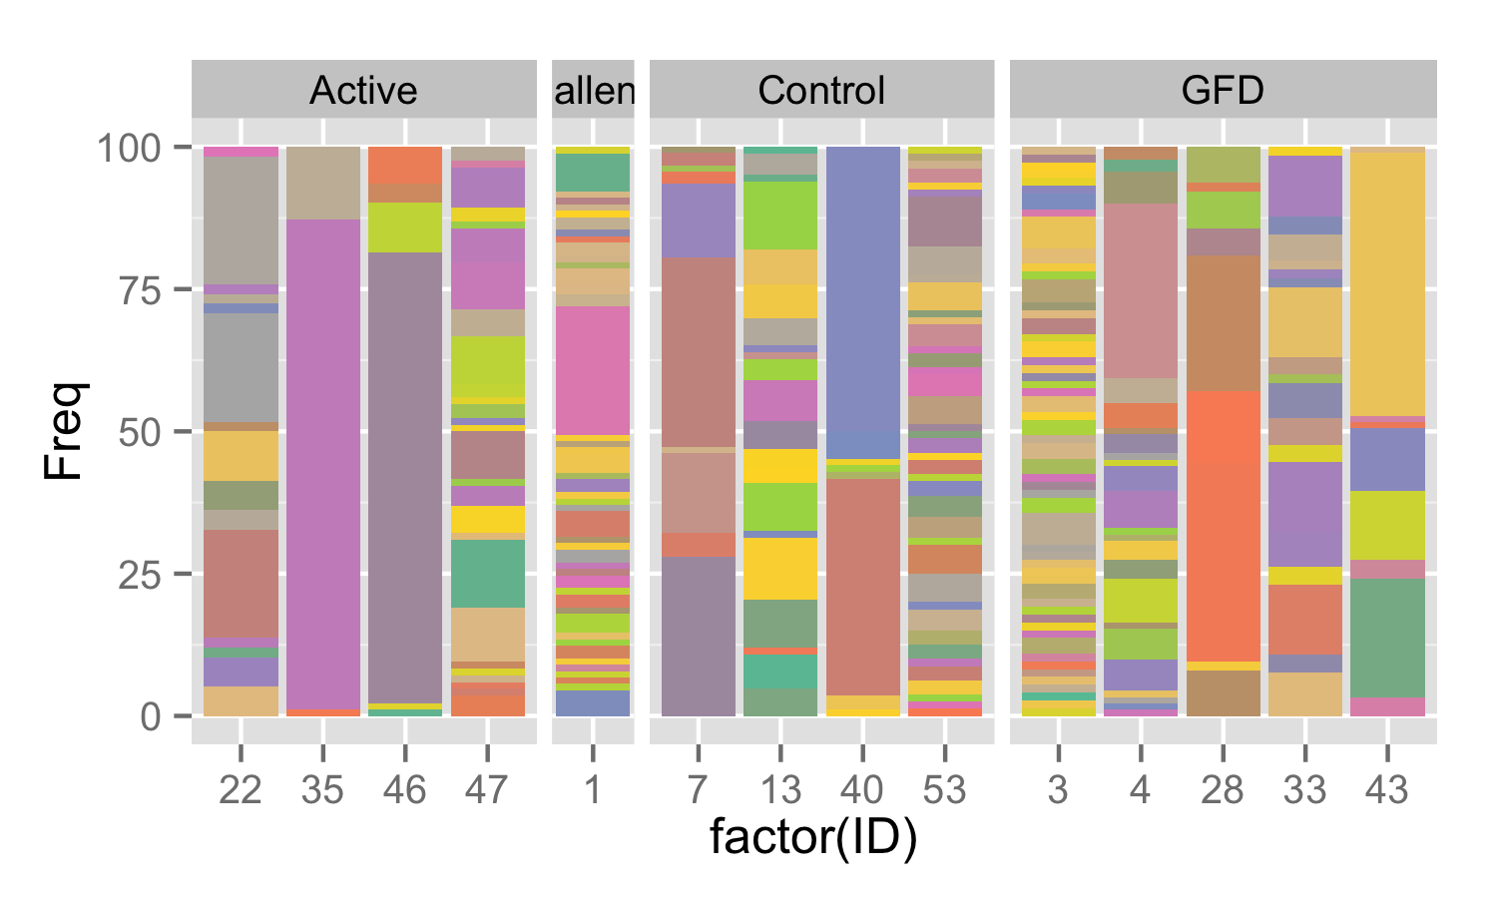
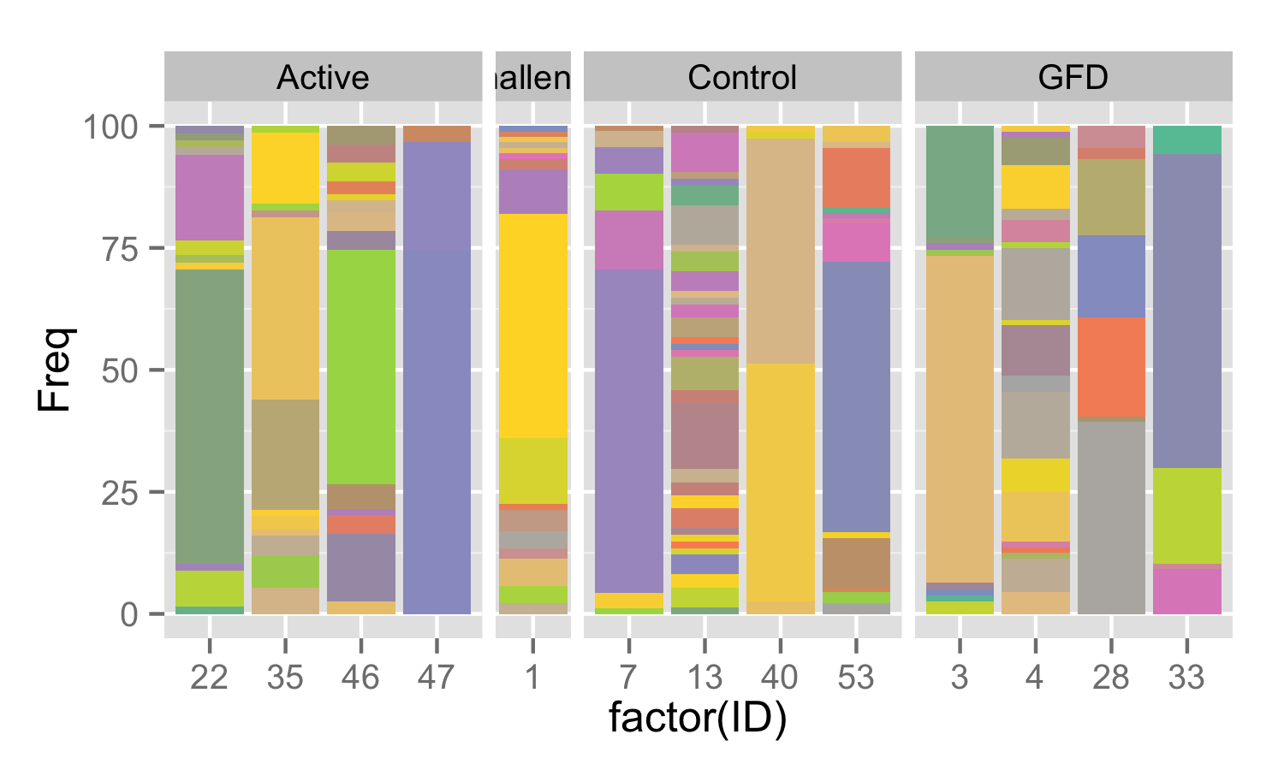
V delta 1 CDR3 Diversity on a Per Subject Basis
IEL
PBL

Slide 11
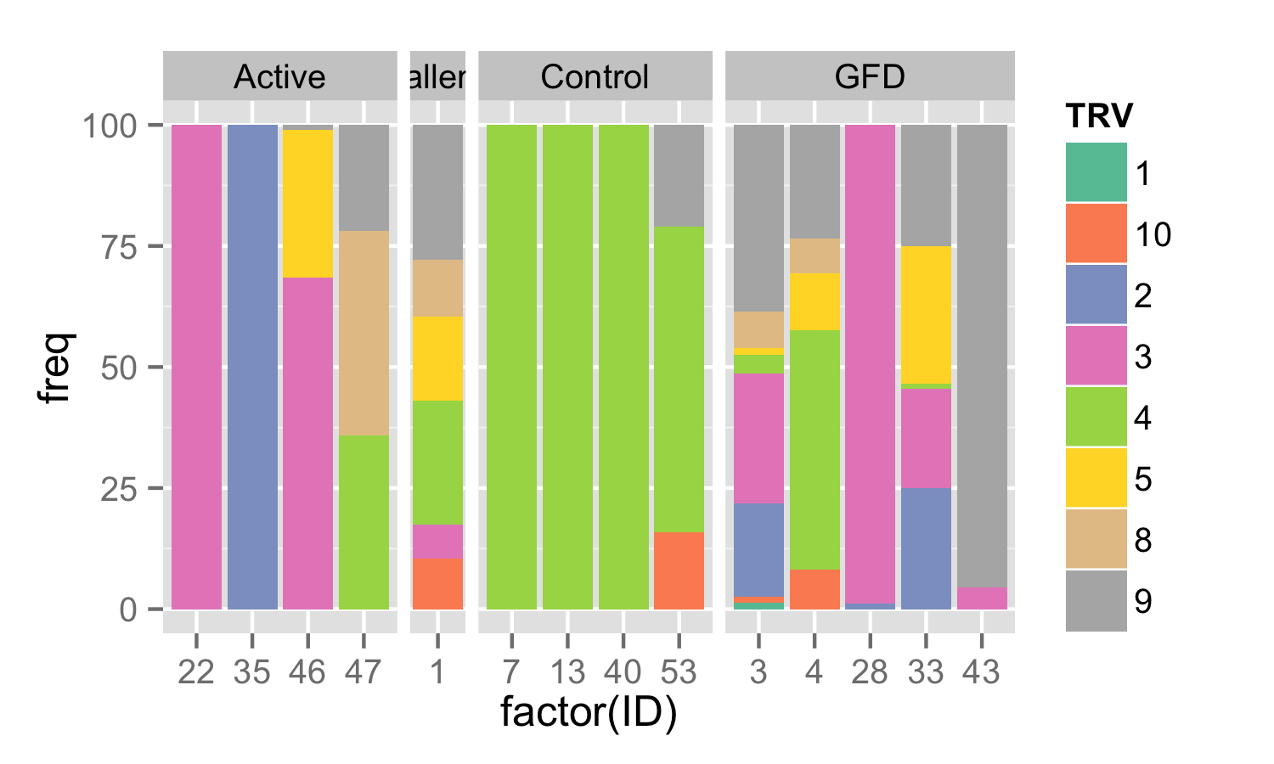
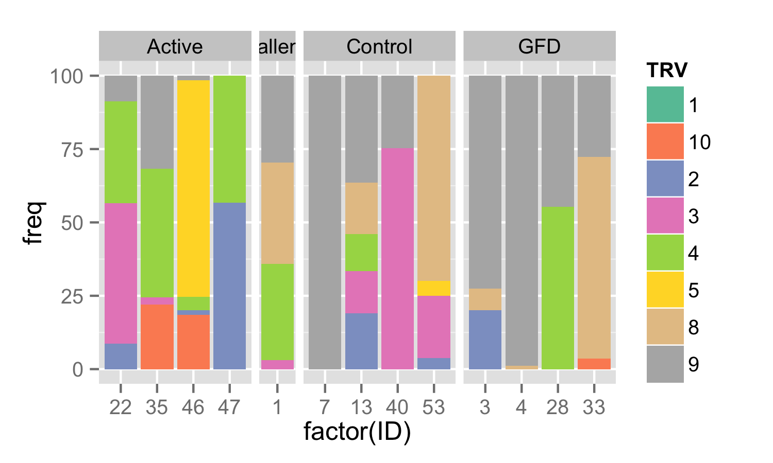
V gamma Usage on a Per Individual Basis
IEL
PBL

Slide 12
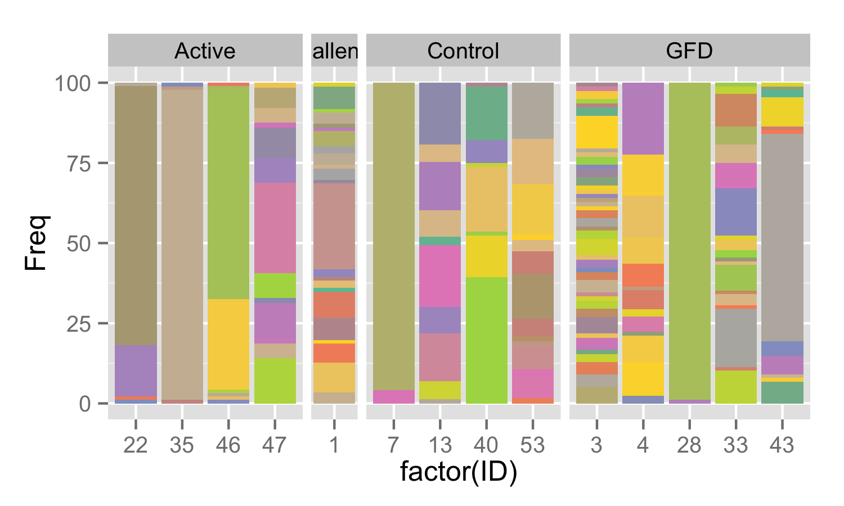
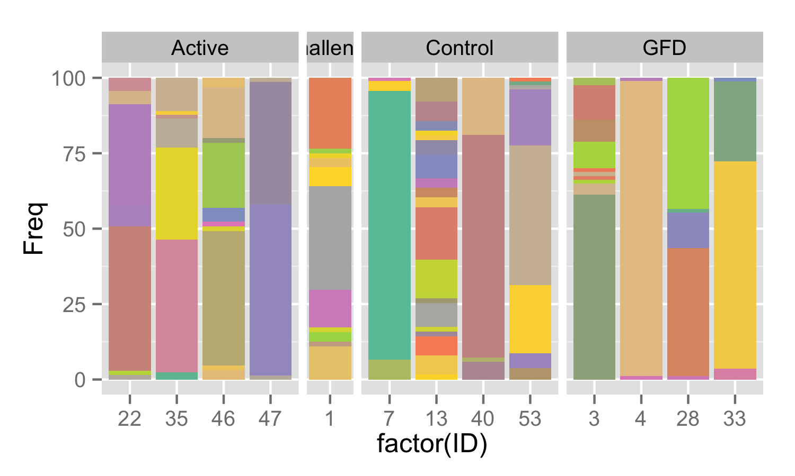
V gamma CDR3 Diversity on a Per Individual Basis
IEL
PBL

Slide 13
Looking at the Whole Picture
Delta CDR3 Diversity
Gamma CDR3 Diversity
IEL
PBL
Notes:
By eye it looks like in the IEL there is less of a 1 to 1 pairing between VD1 and Vgamma CDR3s. For instance patient 22 in the IEL has a dozen or more VD1 CDR3s but has only 3 Vgamma CDR3 sequences so that means the gamma is pairing with different V delta 1s.
This is less apparent in the blood.

Slide 14
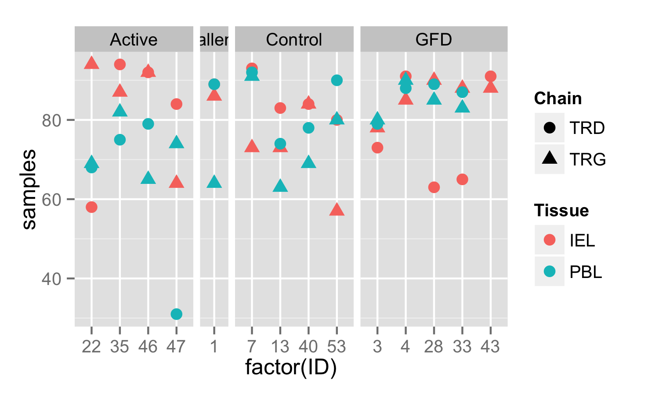
Diversity measurements accounting for sample sizes
I subsampled to 50 to normalize

Slide 15
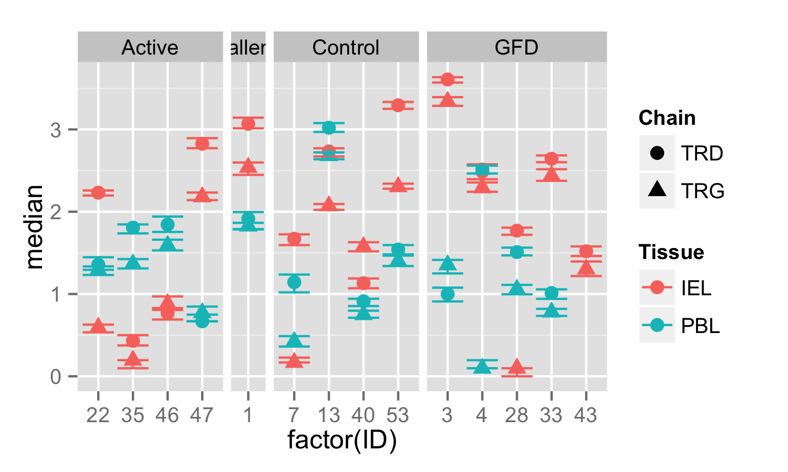
Subsampled Shannon Diversity using Frequencies of Unique CDR3s
Error bars portray 25% and 75% quantiles
Notes:
Diversity within a group is something we need to look at as well because it looks like Actives are the most tight group here.

Slide 16
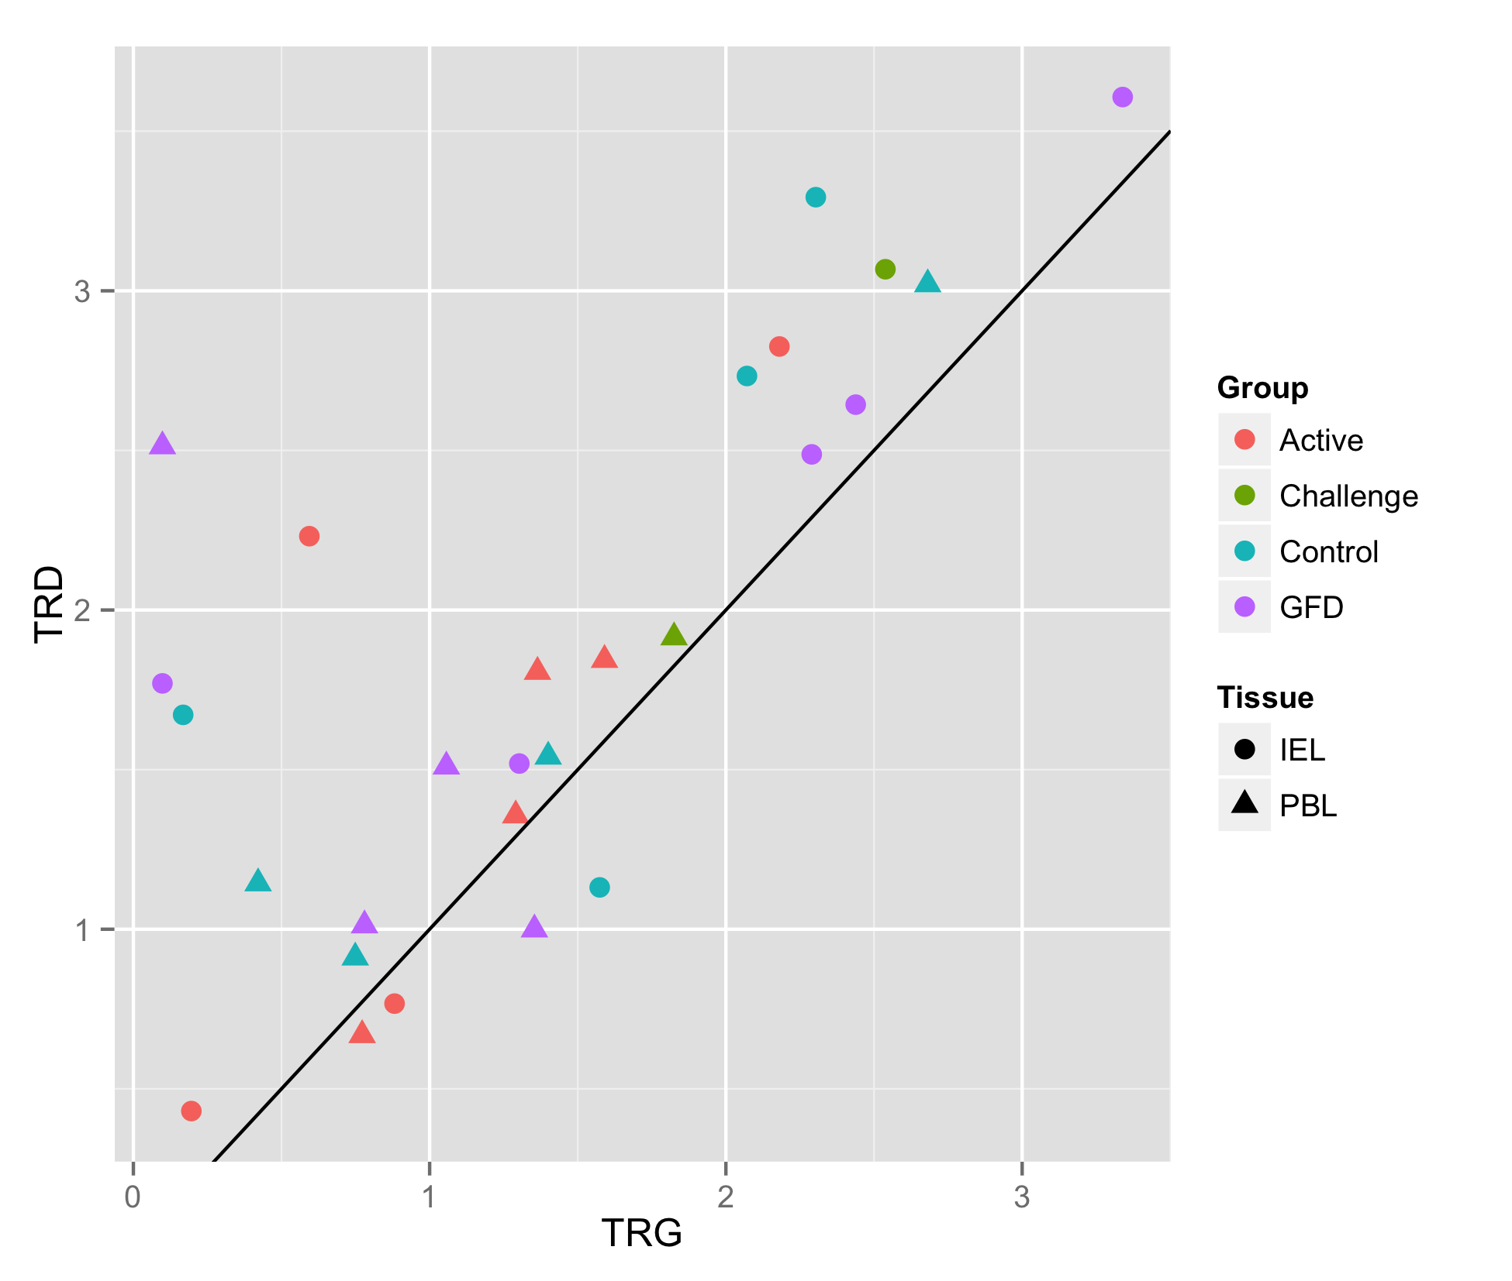
TRD chain tends to be more diverse than TRG chain per individual
Median subsampled Shannon diversity from each individual

Slide 17
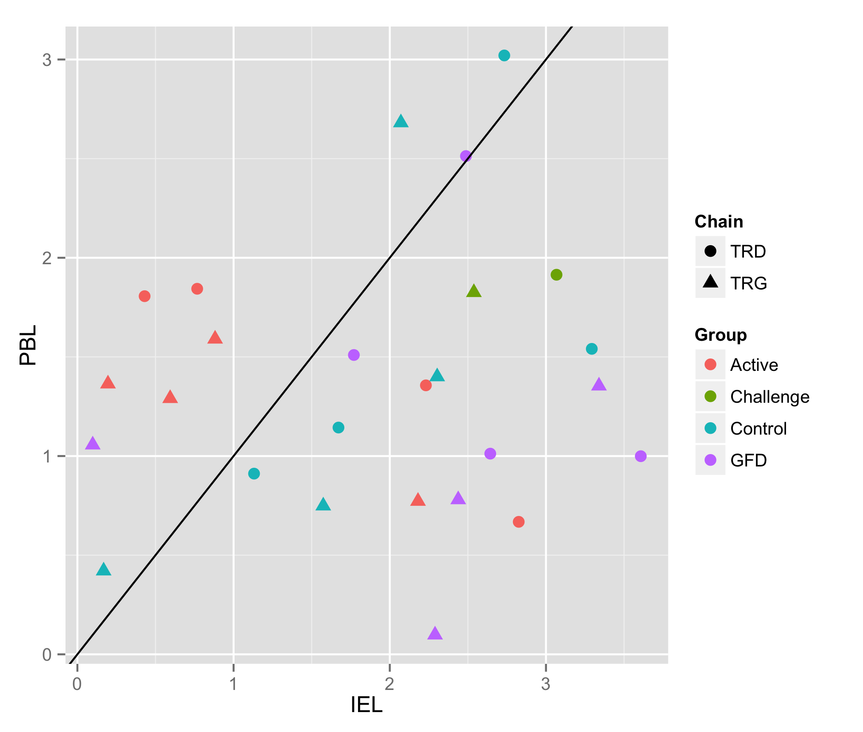
Active Group has Relatively Reduced IEL Diversity
Median subsampled Shannon diversity from each individual

Slide 18
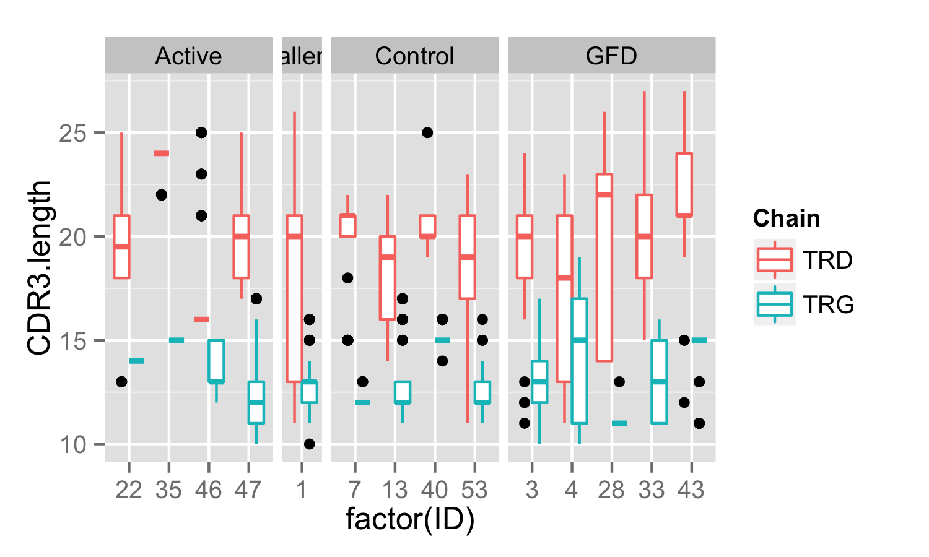
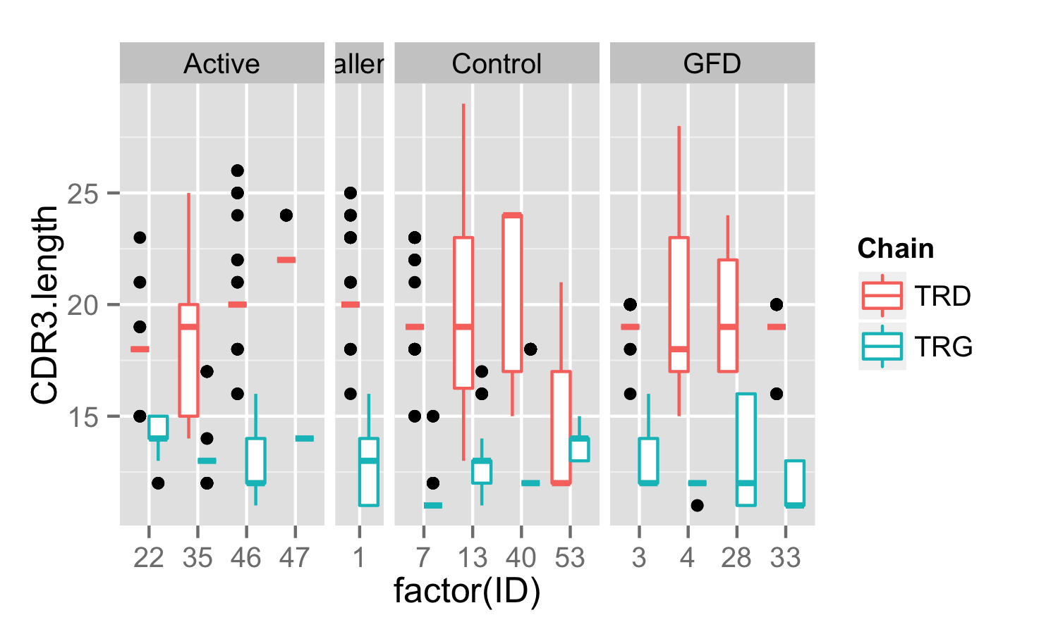
CDR3 Sequence Length
IEL
PBL

Slide 19
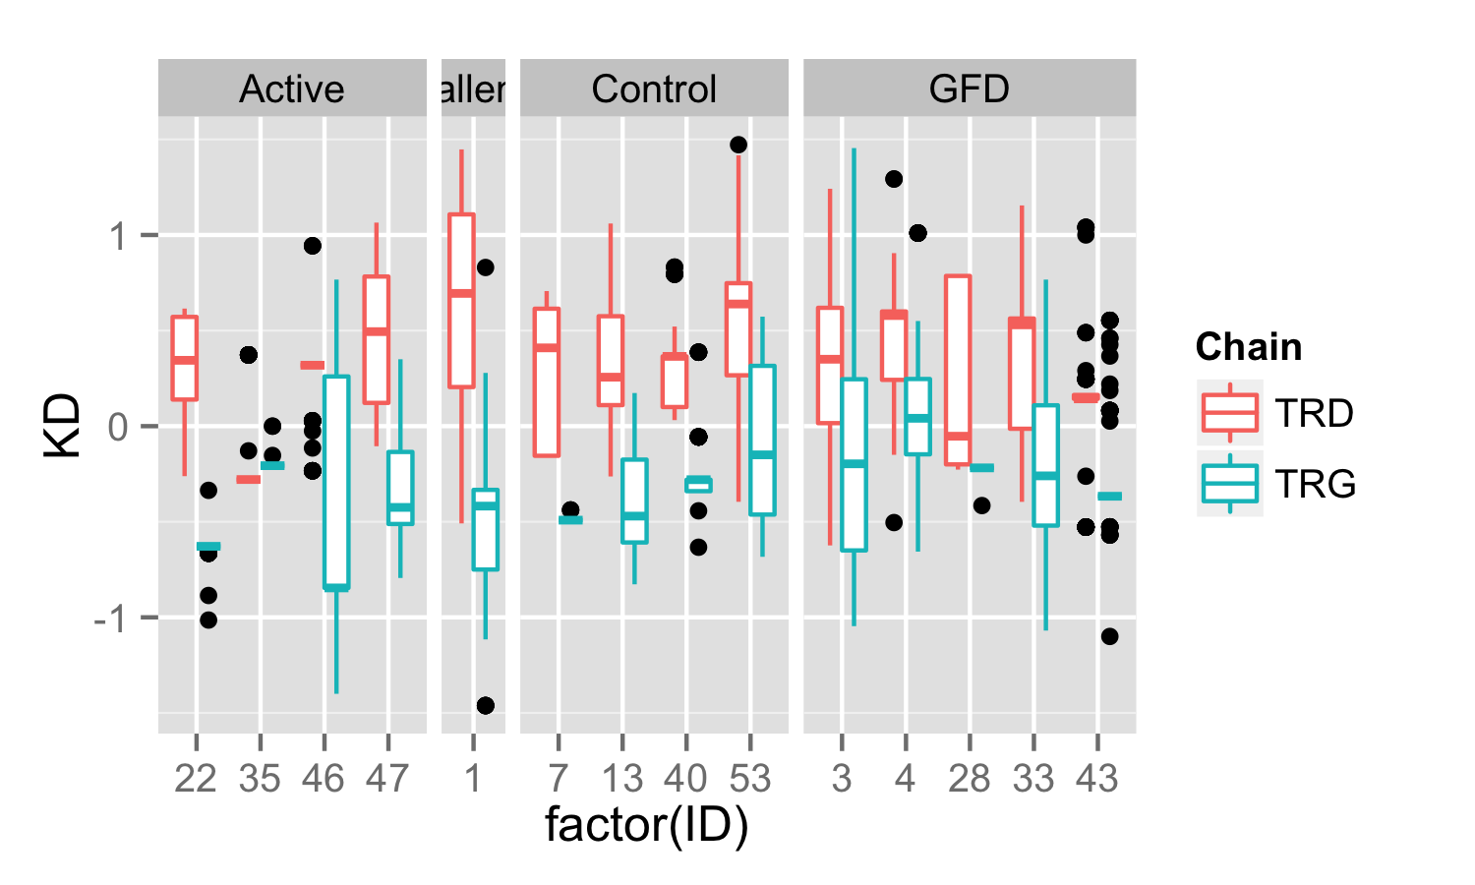
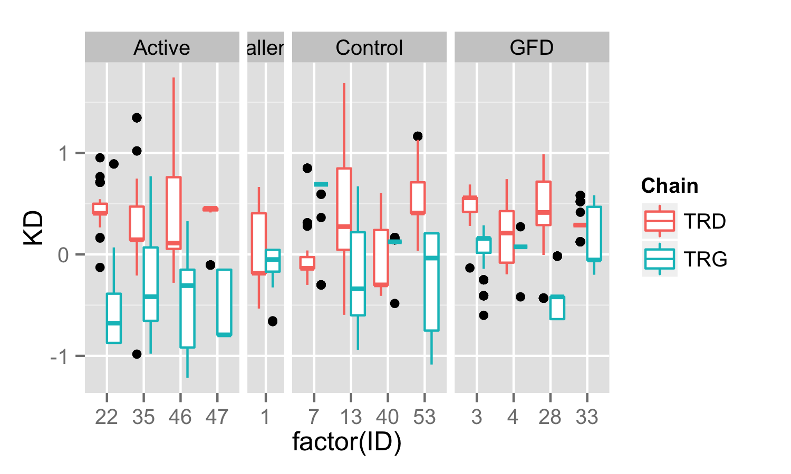
CDR3 Sequence Hydrophobicity (Kyte-Doolittle)
IEL
PBL
Average hydrophobicity per residue
Notes:
Negative is more hydrophilic
Positive is more hydrophobic
I need to look up Kyte-Doolittle

Slide 20
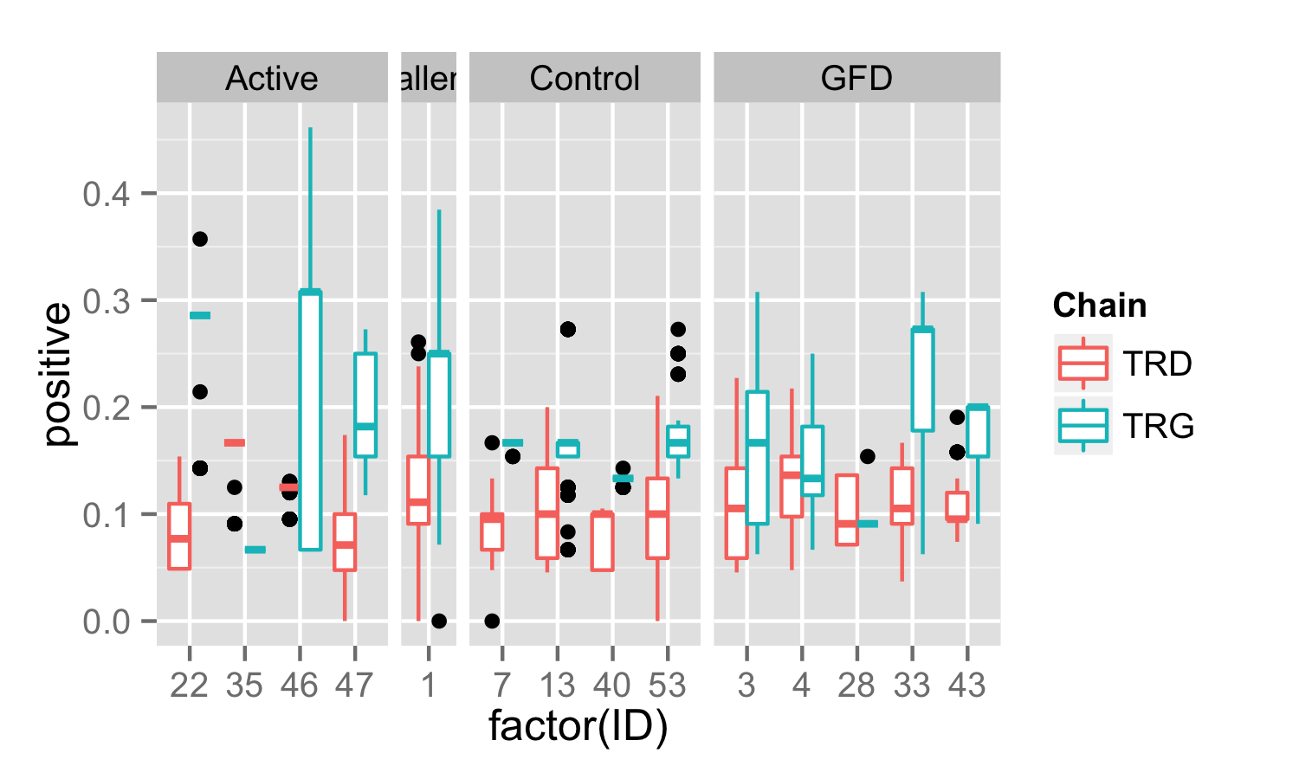
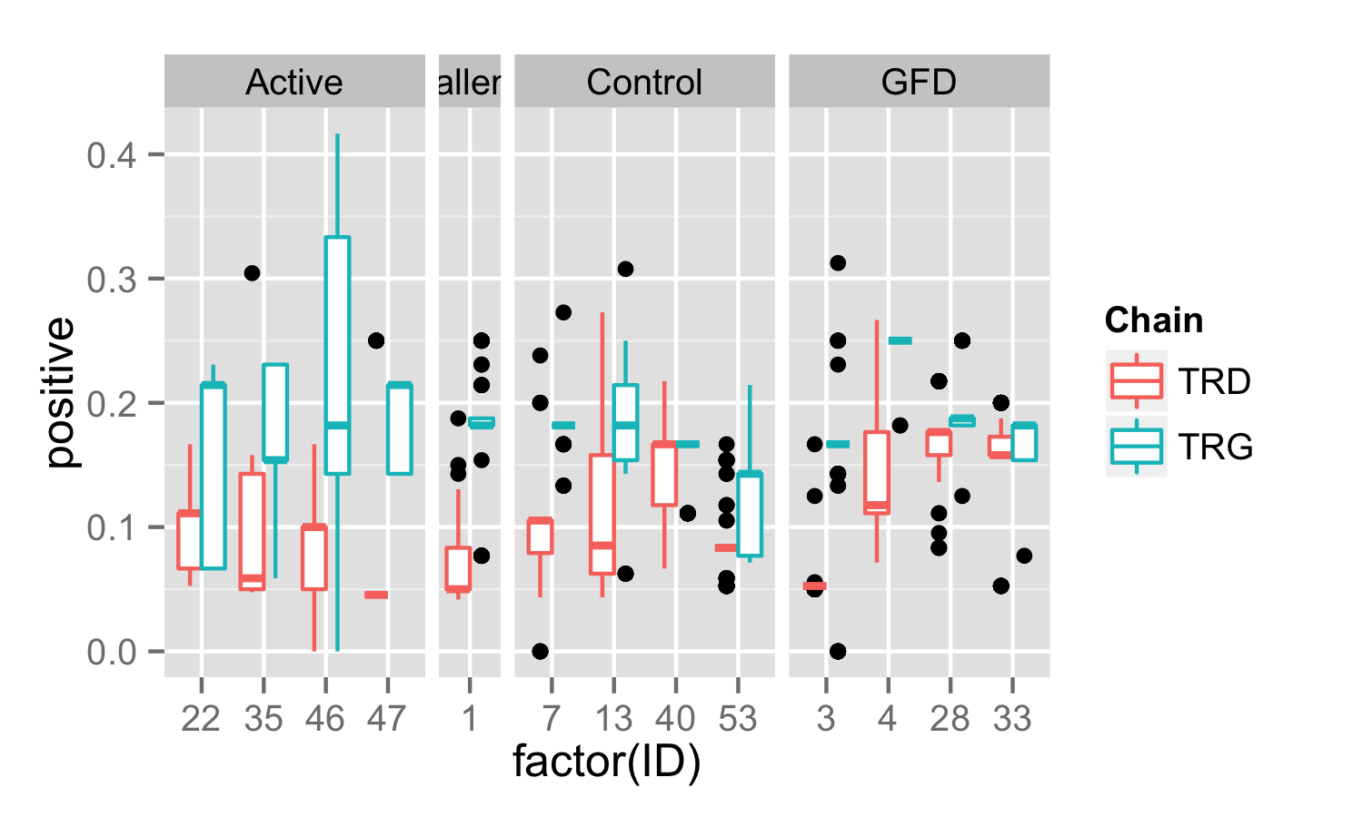
CDR3 Sequence Positive Charge (KRH)
IEL
PBL
Proportion of positively charged residues

Slide 21
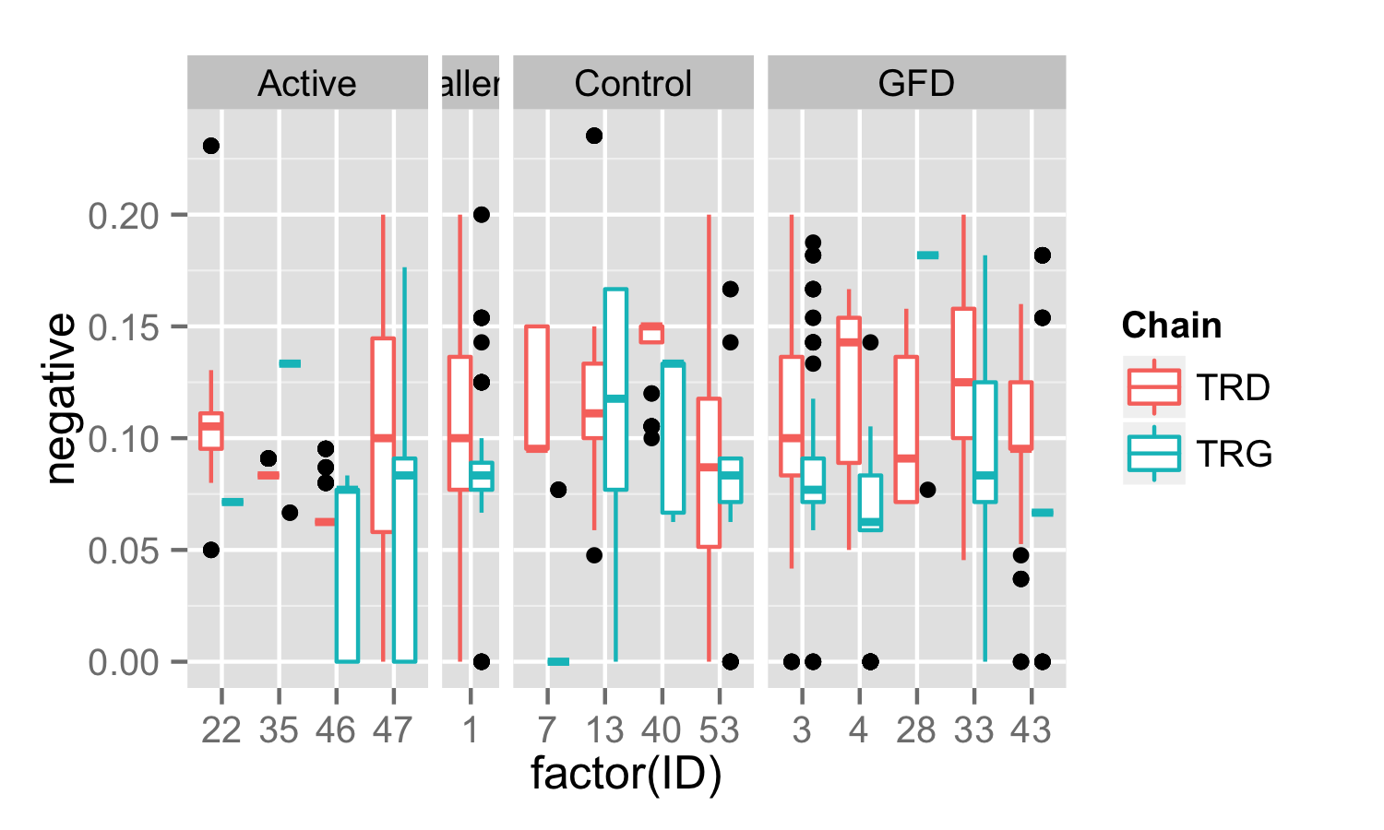
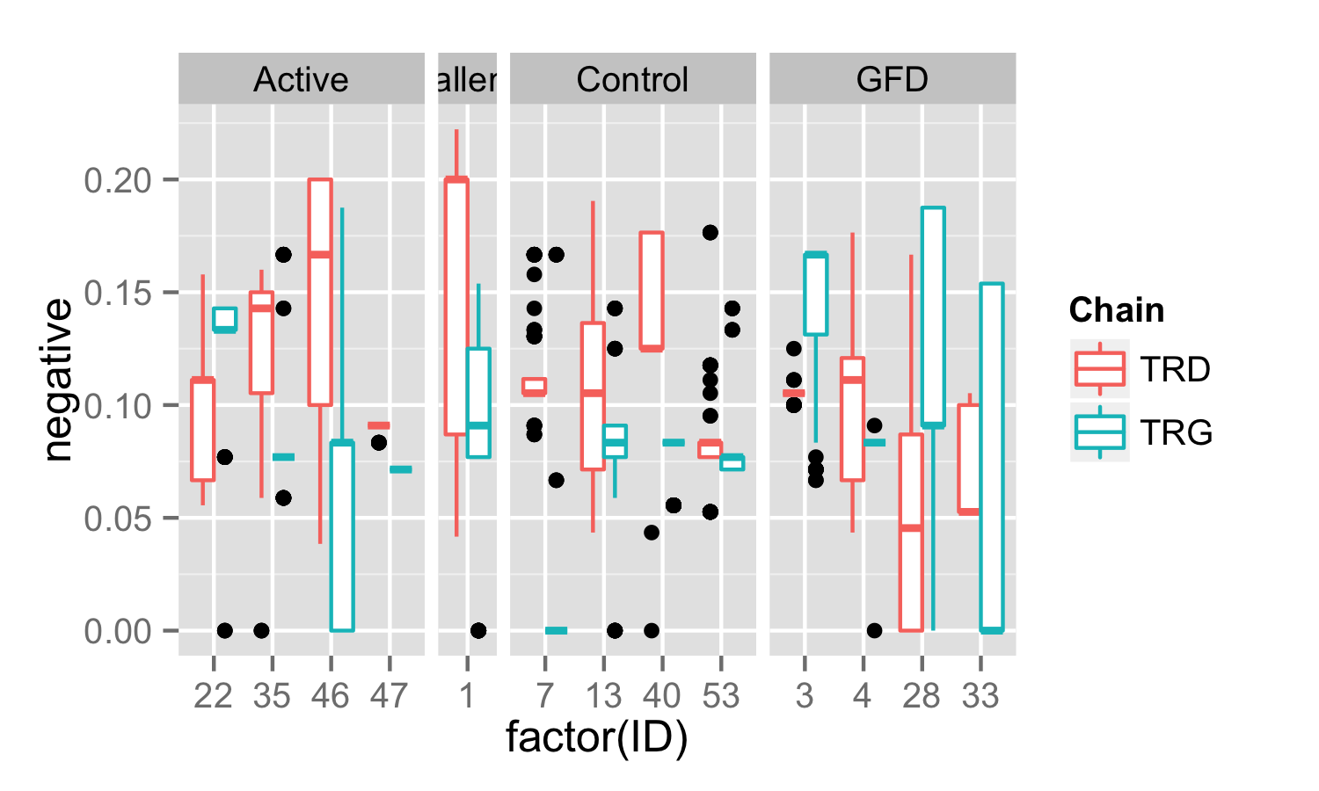
CDR3 Sequence Negative Charge (DE)
IEL
PBL
Proportion of negatively charged residues

Slide 22
Nearly all clones are unique between patients – however there are 4 exact matches
Group | ID | Tissue | Chain | TRV | CDR3 | TRJ | Freq | Count | NT
Active | 35 | IEL | TRD | 1 | CALGDQRVPIPWTGGYRHTDKLIF | 1 | 86.17 | 81 | 2
Active | 46 | PBL | TRD | 1 | CALGDQRVPIPWTGGYRHTDKLIF | 1 | 1.26 | 1 | 1
Challenge | 1 | IEL | TRD | 1 | CALGEYGRGSWGISHTDKLIF | 1 | 2.25 | 2 | 1
Challenge | 1 | PBL | TRD | 1 | CALGEYGRGSWGISHTDKLIF | 1 | 1.12 | 1 | 1
Active | 46 | PBL | TRG | 2 | CATWDGPNYYKKLF | 2 | 1.54 | 1 | 1
GFD | 3 | IEL | TRG | 2 | CATWDGPNYYKKLF | 2 | 5.13 | 4 | 1
Active | 46 | IEL | TRG | 9 | CALWEVLYKKLF | 1/2 | 1.08 | 1 | 1
GFD | 33 | IEL | TRG | 9 | CALWEVLYKKLF | 1/2 | 3.41 | 3 | 1

Slide 23
And 9 other pairs with matching CDR3 sequences
Group | ID | Tissue | Chain | TRV | CDR3 | TRJ | Freq | Count | NT
Challenge | 1 | IEL | TRG | 3 | CATWDRDSSDWIKTF | P2 | 1.16 | 1 | 1
Challenge | 1 | IEL | TRG | 5 | CATWDRDSSDWIKTF | P2 | 1.16 | 1 | 1
Challenge | 1 | IEL | TRG | 4 | CATWDGLYYKKLF | 1 | 3.49 | 3 | 1
GFD | 3 | IEL | TRG | 2 | CATWDGLYYKKLF | 1 | 2.56 | 2 | 1
Control | 13 | PBL | TRG | 2 | CATWDGYYKKLF | 1/2 | 7.94 | 5 | 2
GFD | 3 | IEL | TRG | 2 | CATWDGYYKKLF | 2 | 1.28 | 1 | 1
GFD | 3 | IEL | TRG | 9 | CALWEVDYKKLF | 1 | 5.13 | 4 | 1
GFD | 3 | PBL | TRG | 9 | CALWEVDYKKLF | 1/2 | 61.25 | 49 | 1

Slide 24
Group | ID | Tissue | Chain | TRV | CDR3 | TRJ | Freq | Count | NT
Active | 22 | PBL | TRG | 9 | CALWEVHYYKKLF | 1/2 | 7.25 | 5 | 1
GFD | 3 | PBL | TRG | 9 | CALWEVHYYKKLF | 2 | 1.25 | 1 | 1
GFD | 3 | IEL | TRG | 8 | CATWVYYKKLF | 1 | 1.28 | 1 | 1
GFD | 4 | IEL | TRG | 5 | CATWVYYKKLF | 1 | 11.76 | 10 | 1
GFD | 3 | IEL | TRG | 9 | CALWEVRYKKLF | 1 | 2.56 | 2 | 1
GFD | 4 | PBL | TRG | 9 | CALWEVRYKKLF | 1/2 | 97.78 | 88 | 3
GFD | 4 | PBL | TRG | 8 | CATWDYYKKLF | 1/2 | 1.11 | 1 | 1
GFD | 28 | PBL | TRG | 4 | CATWDYYKKLF | 1/2 | 43.53 | 37 | 1
GFD | 3 | IEL | TRG | 3 | CATWDRPEKLF | 1/2 | 2.56 | 2 | 1
GFD | 33 | IEL | TRG | 3 | CATWDRPEKLF | 1 | 3.41 | 3 | 1

